Slide 1
COS 326 Database Systems
Lecture 3
Object-oriented Databases (2)
Chapter 12 (7th edition)
Tuesday 30 July 2024

Slide 2
In this lecture
Case studies of OODBMSs
ObjectDB
Objectstore
OO Database design
Reading for the student
How do OODBMSs overcome the limitations (weaknesses) of RDBMSs as discussed previously?

Slide 3
Recap: Strategies for developing an OODBMS
One of the strategies is:
To provide an extensible OODBMS library
‘Off-the-shelf’ library
Library provides persistence and database capabilities
No need for separate compiler
Work with known programming languages e.g Java or C++
Examples of OODBMSs are:
ObjectDB : (Java) open source
ObjectStore (C++) commercial
© Pearson Education Limited 1995, 2005

Slide 4
OODBMS Case study: ObjectDB for Java (1)
ObjectDB
ObjectDB is a powerful Object-Oriented Database Management System (ODBMS).
ObjectDB provides all the standard database management services (storage and retrieval, transactions, lock management, query processing, etc.) in a way that makes development easier and applications faster.
Features
100% pure Java Object-Oriented Database Management System (ODBMS).
No proprietary API - managed only by standard Java APIs (JPA 2 / JDO 2).
Suitable for database files ranging from kilobytes to terabytes.
Supports both Client-Server mode and Embedded mode.
Single JAR with no external dependencies.
Database is stored as a single file.
Advanced querying and indexing capabilities.
Effective in heavy loaded multi-user environments.
Can easily be embedded in applications of any type and size

Slide 5
OODBMS Case study: ObjectDB for Java (2)
Object Identifier (OID)
One goal of an OODB is to maintain a direct correspondence between real-world and database objects so that objects do not lose their integrity and identity and can easily be identified and operated upon.
Hence, a unique identity is assigned to each independent object stored in the database.
This unique identity is typically implemented via a unique, system-generated object identifier (OID).(QBE)

Slide 6
OODBMS Case study: ObjectDB for Java (3)
Defining a JPA Entity Class
Jakarta Persistence API (formerly Java Persistence API) defines a standard for management of persistence and object/relational mapping in Java(R) environments.
A JPA entity class is a POJO (Plain Old Java Object) class, i.e. an ordinary Java class that is marked (annotated) as having the ability to represent objects in the database.Example (QBE)

Slide 7
OODBMS Case study: ObjectDB for Java (4)
The Point Entity Class
The following Point class, which represents points in the plane, is marked as an entity class,
Provides the ability to store Point objects in the database and retrieve Point objects from the database

Slide 8
ObjectDB– example from the ObjectDB Manual
package com.objectdb.tutorial;
import javax.persistence.Entity;
@Entity
public class Point {
// Persistent Fields:
private int x;
private int y;
// Constructor:
Point (int x, int y) {
this.x = x;
this.y = y;
}
// Accessor Methods:
public int getX() { return this.x; }
public int getY() { return this.y; }
// String Representation:
@Override
public String toString() {
return String.format("(%d, %d)", this.x, this.y);
}
}

Slide 9
OODBMS Case study: ObjectDB for Java (5)
Database Connections in Object DB
In JPA a database connection is represented by the EntityManager interface. Therefore, in order to manipulate an ObjectDB database we need an EntityManager instance.
Operations that modify database content also require an EntityTransaction instance.

Slide 10
OODBMS Case study: ObjectDB for Java (6)
Obtaining an EntityManagerFactory
Obtaining an EntityManager instance consists of two steps.
1. Obtain an instance of EntityManagerFactory that represents the relevant database
2. Use that factory instance to get an EntityManager instance.
EntityManagerFactory emf =
Persistence.createEntityManagerFactory(
"objectdb:$objectdb/db/points.odb");

Slide 11
OODBMS Case study: ObjectDB for Java (7)
Obtaining an EntityManager
Once we have an EntityManagerFactory we can easily obtain an EntityManager instance:
The EntityManager instance represents a connection to the database.
When using JPA, every operation on a database is associated with an EntityManager.
EntityManager em = emf.createEntityManager();

Slide 12
OODBMS Case study: ObjectDB for Java (8)
Using an EntityTransaction
Operations that modify database content, such as store, update, and delete should only be performed within an active transaction.
Given an EntityManager, em, you begin a transaction in the following way:
There is a one to one relationship between an EntityManager instance and its associated EntityTransaction instances that the getTransaction method returns.
em.getTransaction().begin();

Slide 13
OODBMS Case study: ObjectDB for Java (9)
CRUD Operations using ObjectDB
Given an EntityManager, em, that represents a JPA connection to the object database, we can use it to store, retrieve, update and delete database objects as follows:

Slide 14
OODBMS Case study: ObjectDB for Java
Operations | Examples
1. Storing New Entity Objects | em.getTransaction().begin(); for (int i = 0; i < 1000; i++) { Point p = new Point(i, i); em.persist(p); } em.getTransaction().commit();
2. Reading Entity objects | Query q1 = em.createQuery("SELECT COUNT(p) FROM Point p"); System.out.println("Total Points: " + q1.getSingleResult());

Slide 15
OODBMS Case study: ObjectDB for Java
Operation | Examples
3. Delete Entities | em.getTransaction().begin(); em.remove(p); // delete entity em.getTransaction().commit();
4. Update Entities | em.getTransaction().begin(); p.setX(p.getX() + 100); // update entity em.getTransaction().commit();

Slide 16
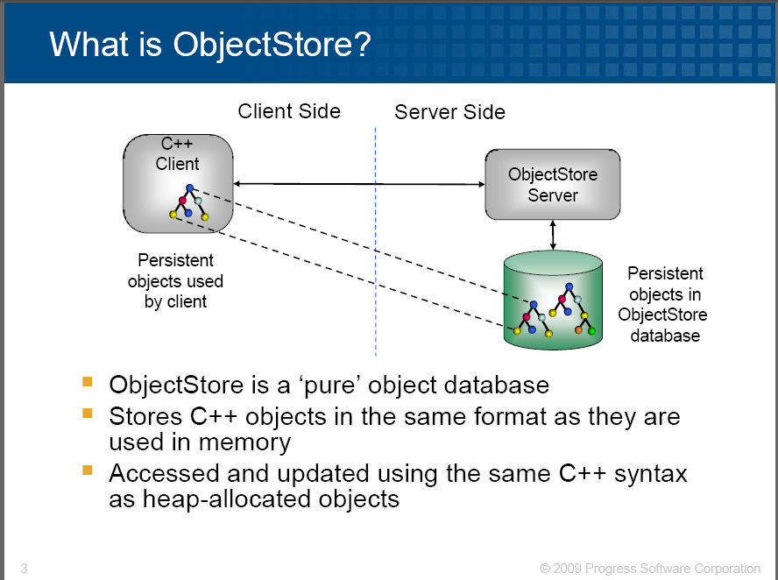
OODBMS Case study: ObjectStore and C++ (1)
Commercial
OODBMS
Heap-allocated objects

Slide 17
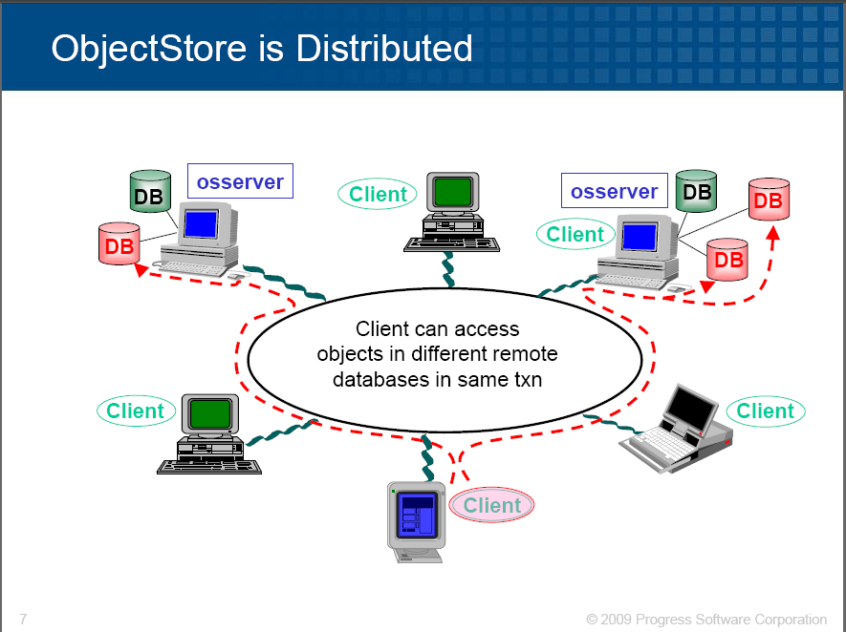
OODBMS Case study: ObjectStore and C++ (2)

Slide 18
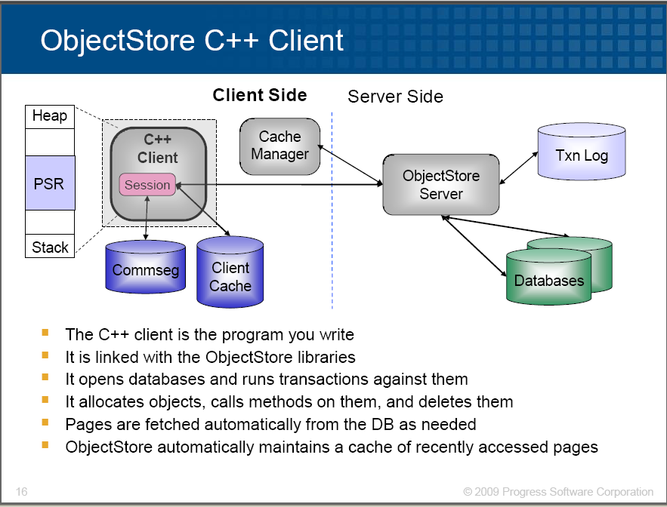
OODBMS Case study: ObjectStore and C++ (3)
Client is a C++ application program

Slide 19
Recap: Limitations (‘weaknesses’) of RDBMs (1)
1. Poor representation of “real world” entities
Normalization leads to relations that do not correspond to entities in the “real world”
joins needed to obtain information from relations (tables)
2. Semantic Overloading
Single construct for representing data and data relationships: the relation
No mechanism to distinguish between relations & relationships or between different types of relationships
How does OODBMSs e.g. ObjectDB overcome the above limitations?

Slide 20
Solutions provided by OODBMs e.g ObjectDB
1. Representation of “real world” entities
OOP constructs are used: classes, inheritance, composition, etc.
Joins are not used (there are no tables in the db)
2. No semantic overloading.
Object identifier (OID) generated by DBMS
Logical OID: Independent of physical location on disk
Physical OID: Points to an actual location on disk
Representation of relationships (business rules):
one-to-one , one-to-many, many-to-many relationships (OBJECT COMPOSITION) done using OIDs
Representation of inheritance relationships:
done through class definitions

Slide 21
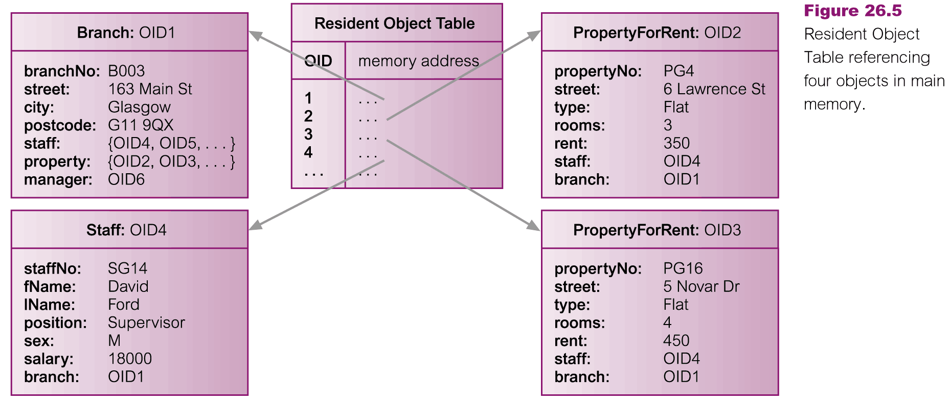
Object access: e.g. Resident object table (ROT)
e.g. of locating objects:
Lookup virtual memory pointer (in ROT) with each object access
OIDs obtained from DBMS
using constructors & overloaded new operator
© Pearson Education Limited 1995, 2005

Slide 22
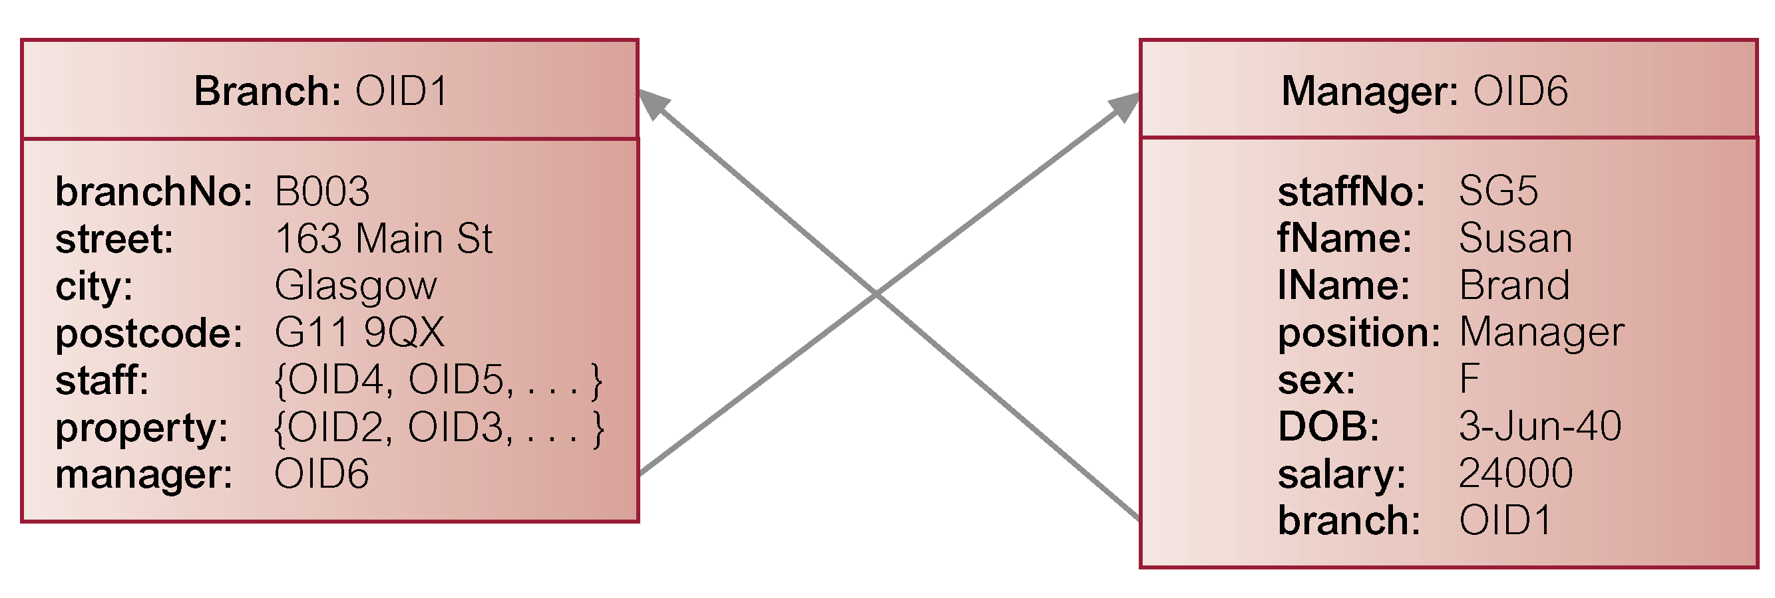
1:1 Relationship between objects A and B
-to-one relationship
Add reference attributes to both objects
Reference is an OID (Recall: OIDs obtained from DBMS)
© Pearson Education Limited 1995, 2005

Slide 23
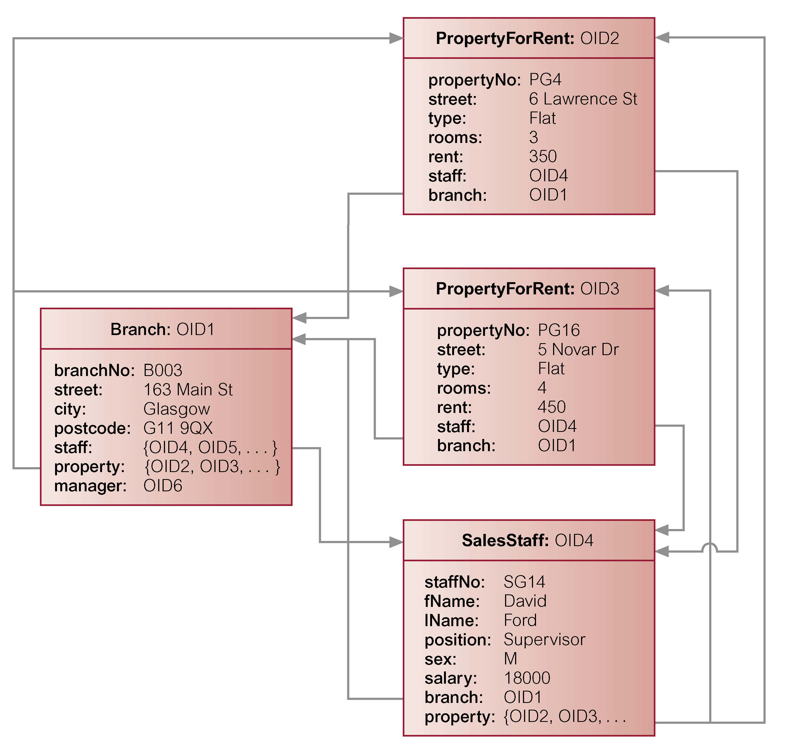
1:* Relationship between objects A and B,C,D,…
One-to-many
Relationship
e.g. one Branch has many Properties for rent
Add reference attribute
to one object (branch in PropertyForRent)
AND
attribute containing set
of references to the
other objects
(property in Branch)
So, how are the problems caused by joins eliminated?

Slide 24
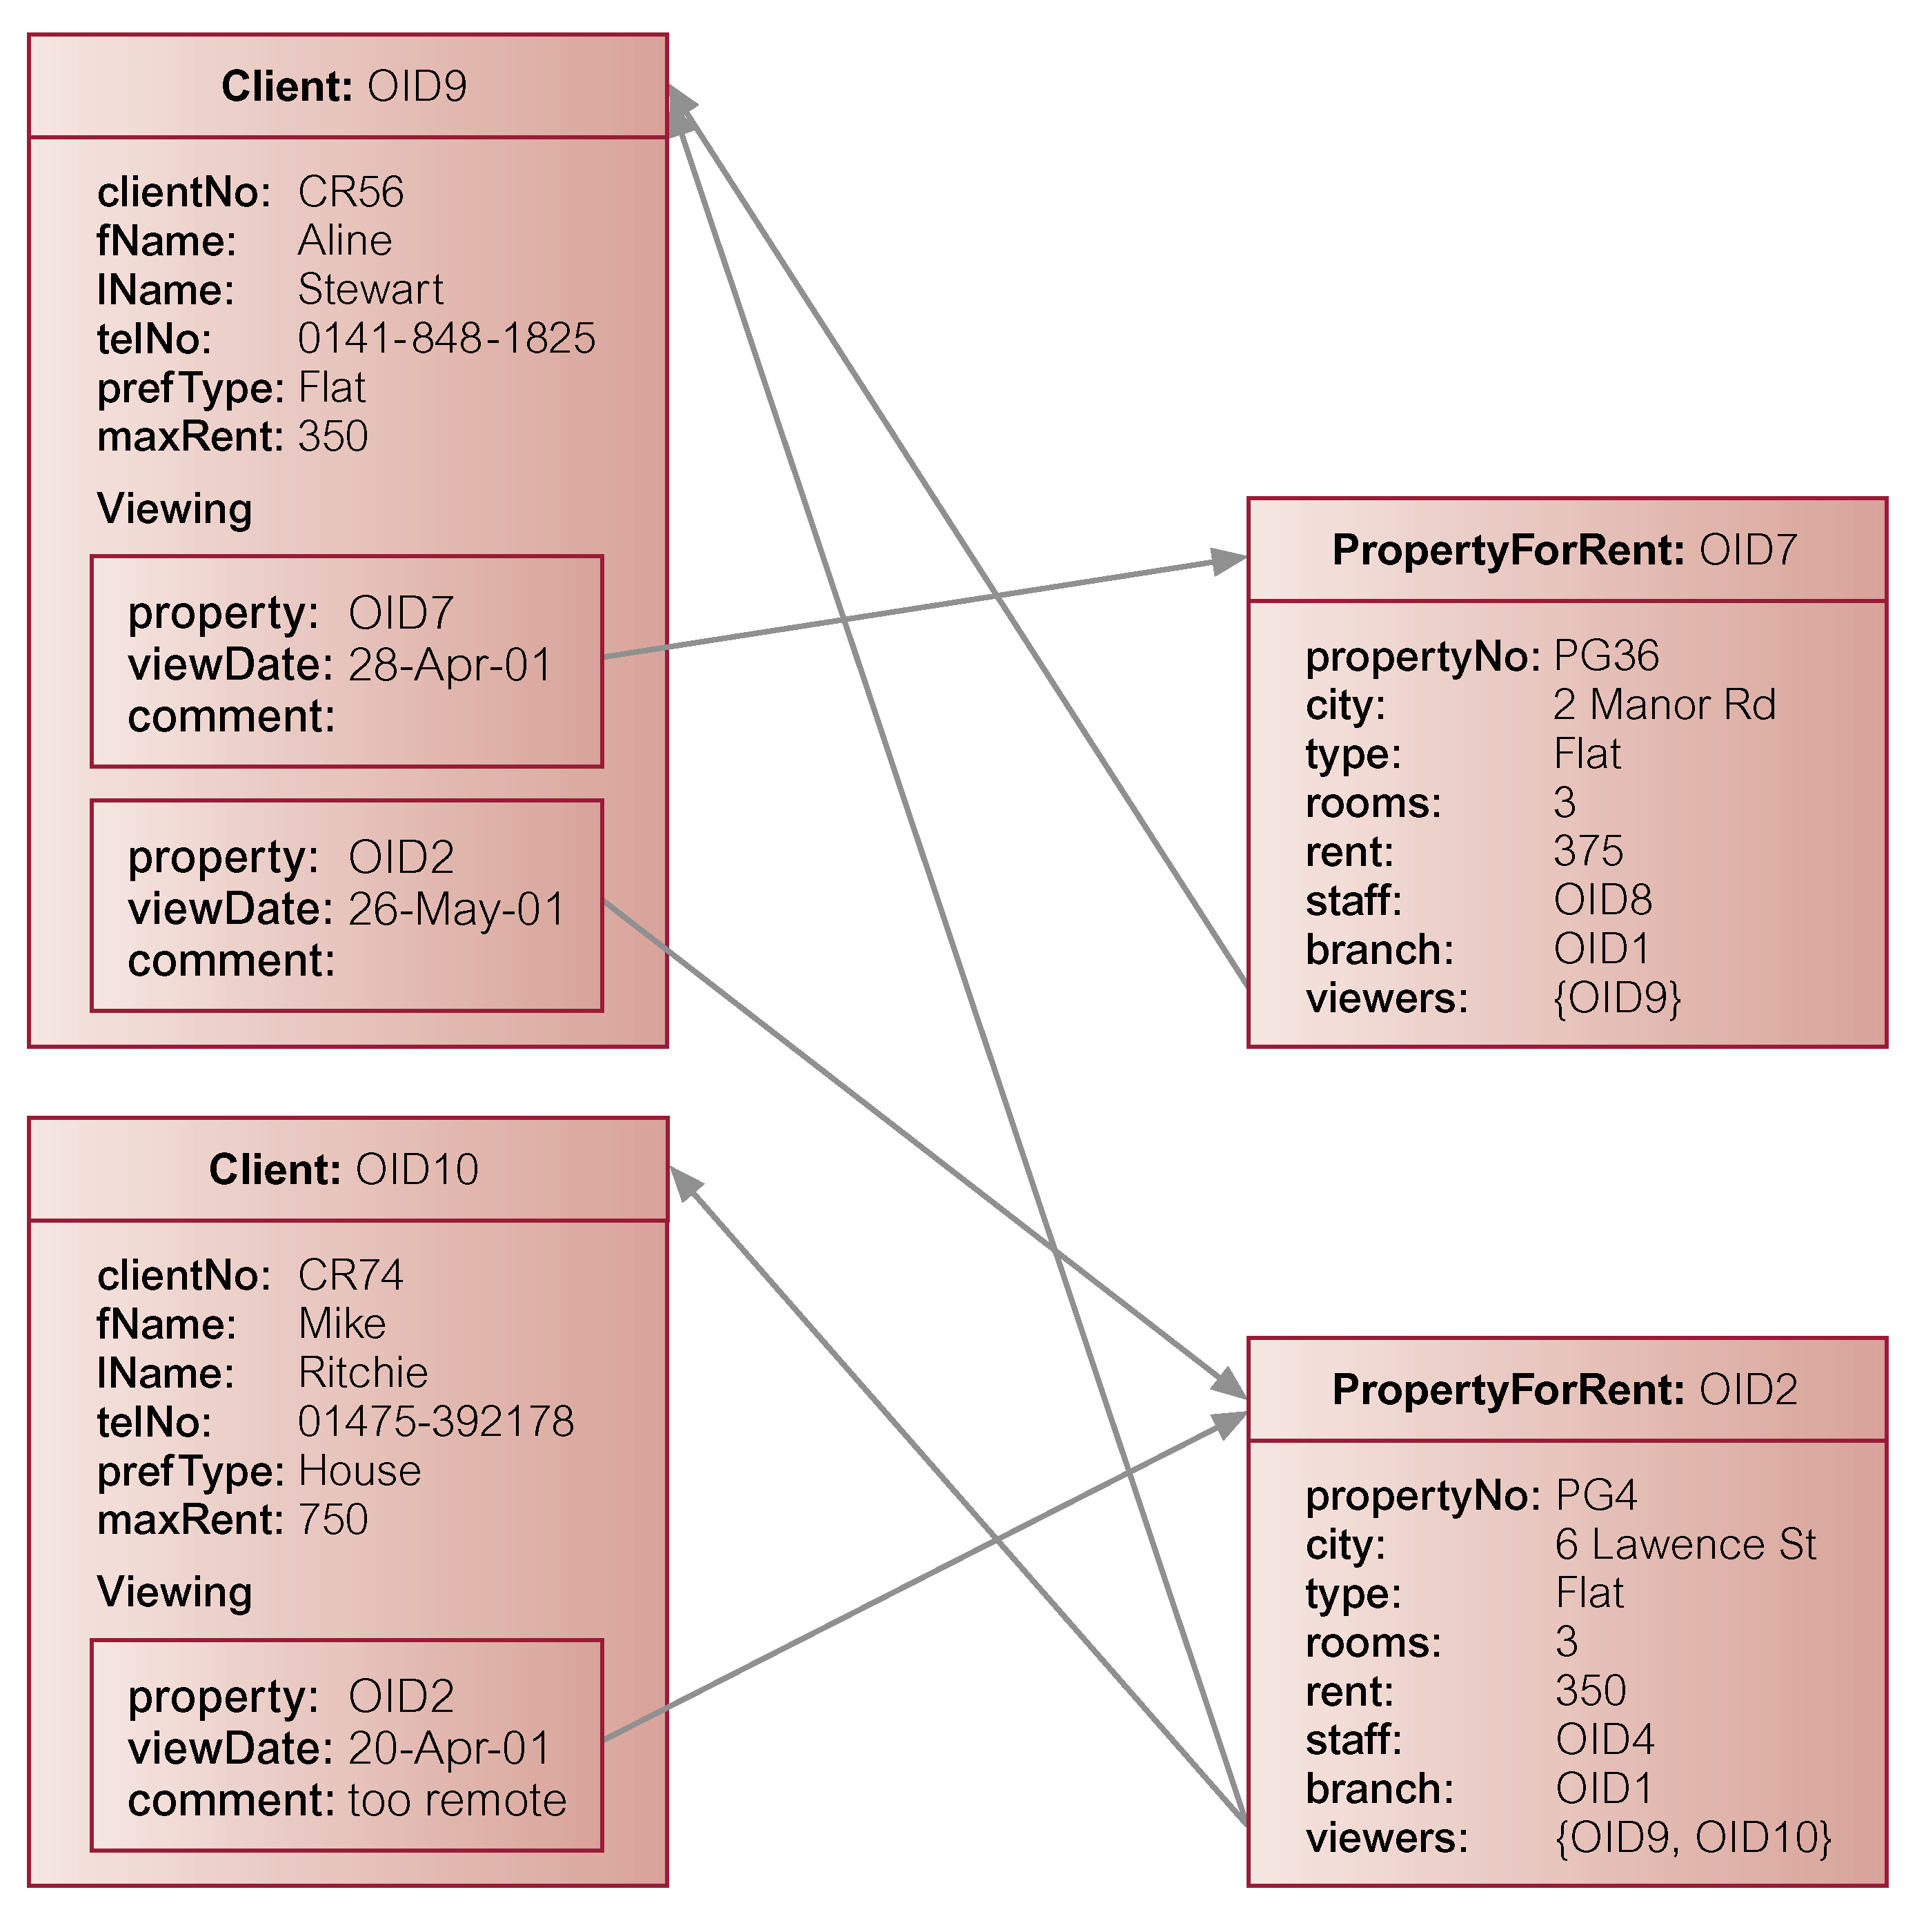
Many-to-many ( *:* ) relationships
Client can view many properties.
A property can-be viewed by many clients
Add
attribute containing set of references
to
each object
© Pearson Education Limited 1995, 2005

Slide 25
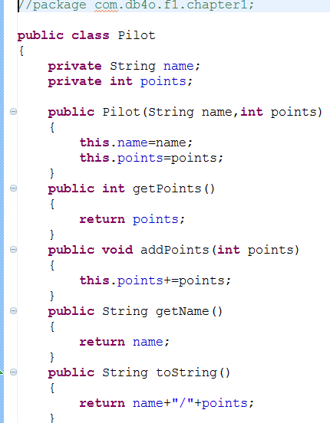
Recap: Limitations (weaknesses) of RDBMs (2)
3. Limited Operations
RDBMSs only have a fixed set of operations which cannot be extended i.e. operations on relations (sets of tuples) & tuples
Not possible to specify new operations (BUT: can use stored procedures)
How do OODBMSs e.g. ObjectDB overcome the above limitations?
Solution: OOP methods are defined for classes
e.g. Pilot class
Pilot class for OODB

Slide 26
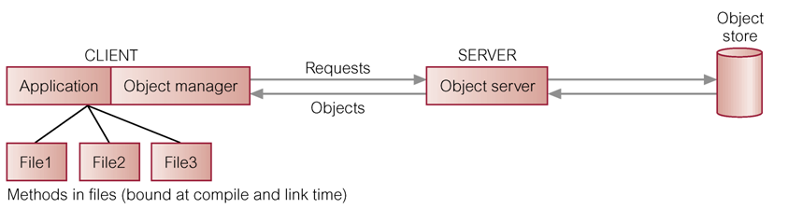
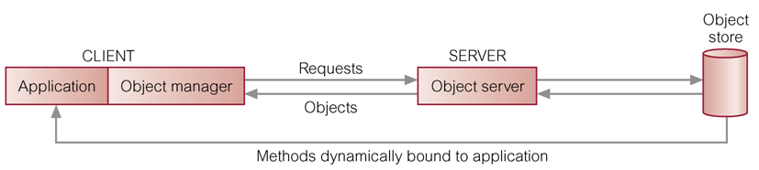
Storing and executing methods
1. Store methods in external files
Link libraries into the application at compile / link time
Eliminates redundant code,
Simplifies modifications,
Methods are more secure,
Methods can be shared concurrently,
Improved integrity
2. Store methods in database
Dynamically bound to application at run-time
© Pearson Education Limited 1995, 2005

